Slide 1

The Ethicalscan
Fashion shouldn’t cost lives or our planet.

Slide 2

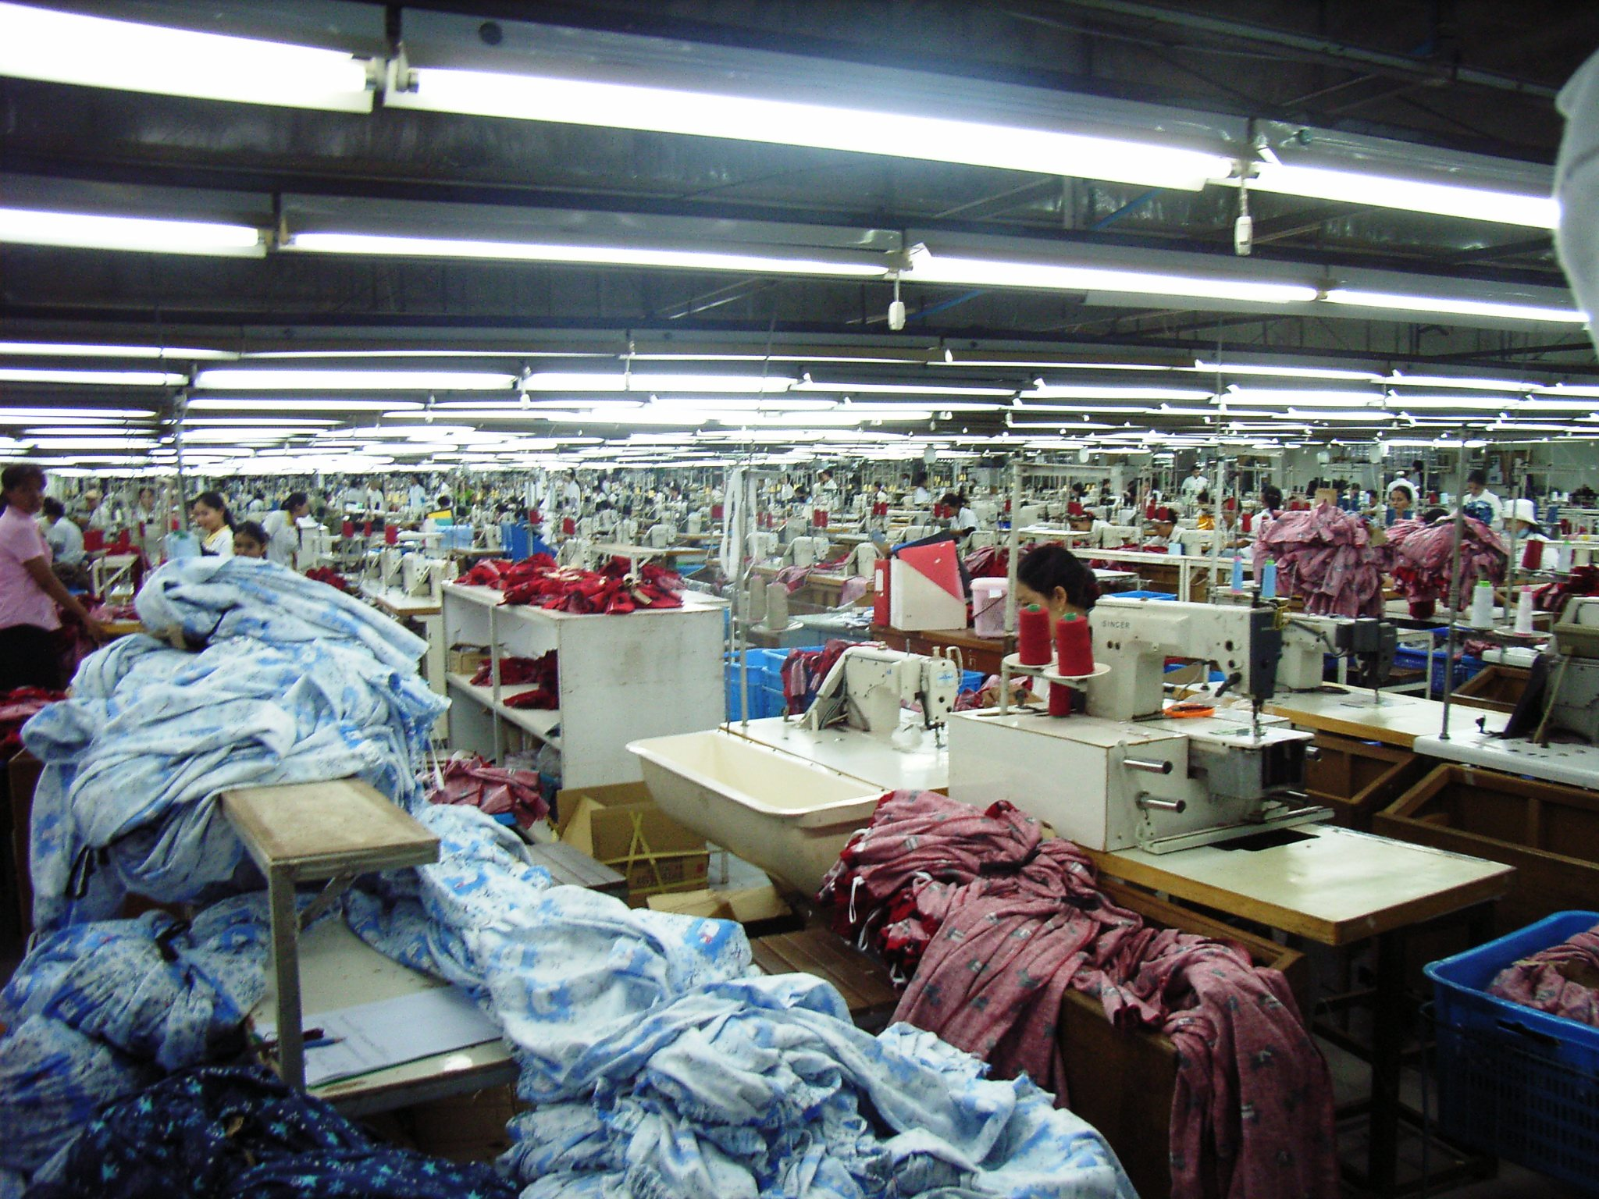
40 million people are living in modern slavery today, many of whom are working in the supply chains of western clothing brands.
Notes:
In 2019 $US128 billion fashion garments were sold in G20 states produced by modern slavery.

Slide 3

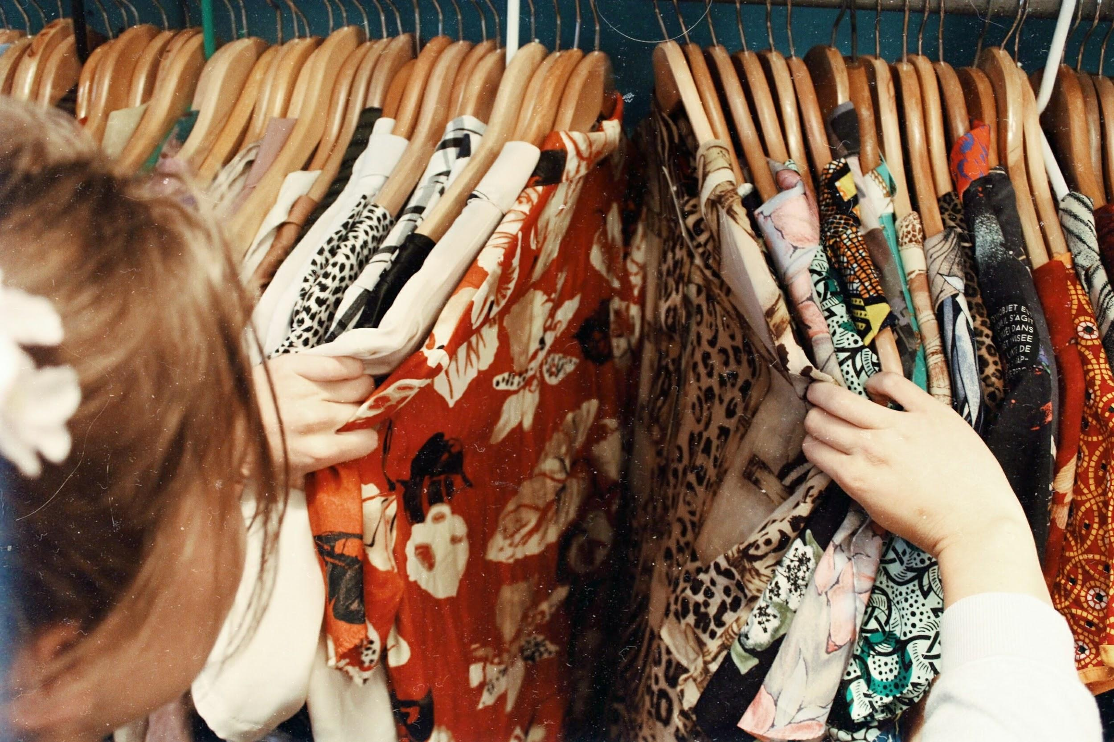
Do you actually know what you’re wearing?

Slide 4
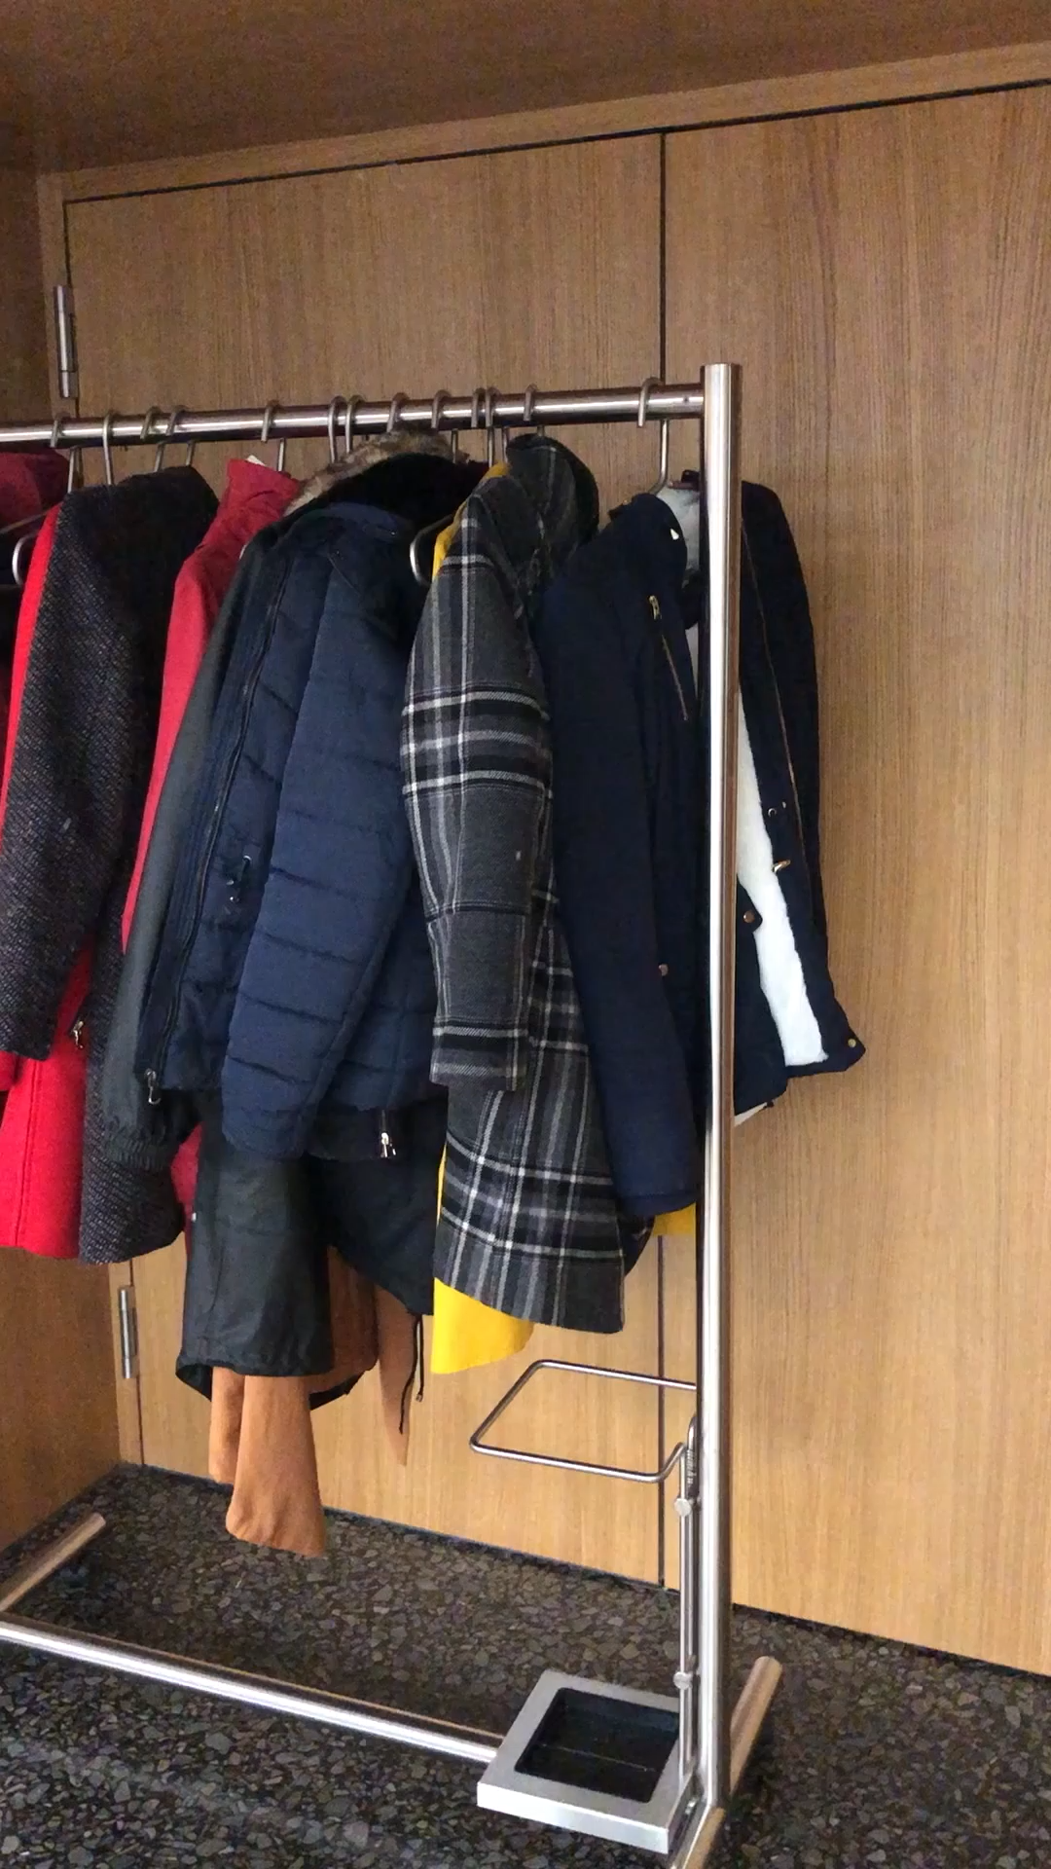

Slide 5





Competition
Neutral, trustworthy datasources
Lists
in PDF
Can be used whilst shopping
Data comes from corporate

Slide 6
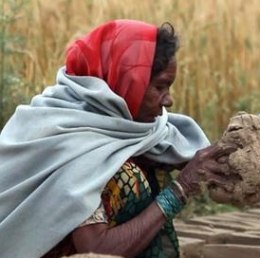
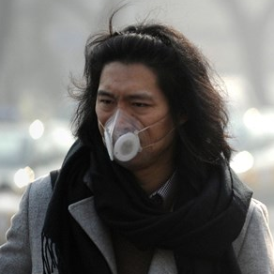

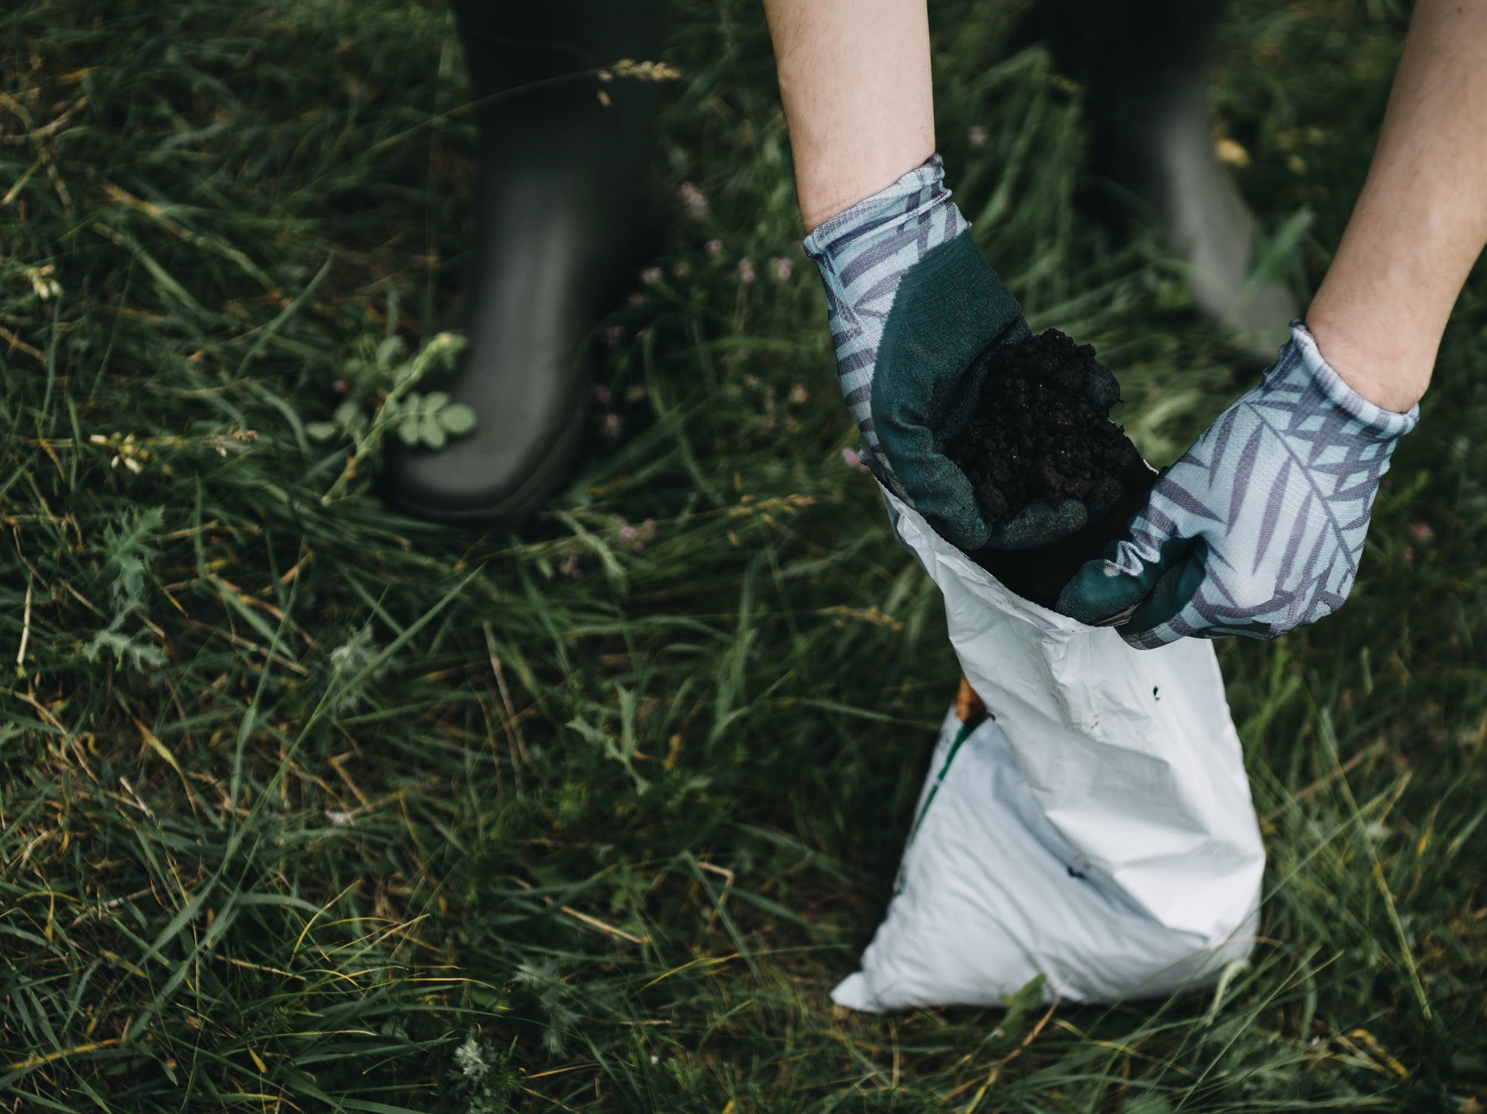

Criteria
Slavery
Salary
Child Labour
Sources
Environment
Toxiety
Local communities & producers
Labour
Sustainability
Fair Trade

Slide 7
Combined Datasources
Database
Supply-Chain Data from the company
Trusted News
Sources
&
Specialized
NGOs

Slide 8

Importance of sustainable fashion
113% per Year
2019
13 Billion sales
in sustainable fashion
2025

Slide 9







Businessmodel
Multi-Sided-Platform
Payed
Free
Platform

Slide 10
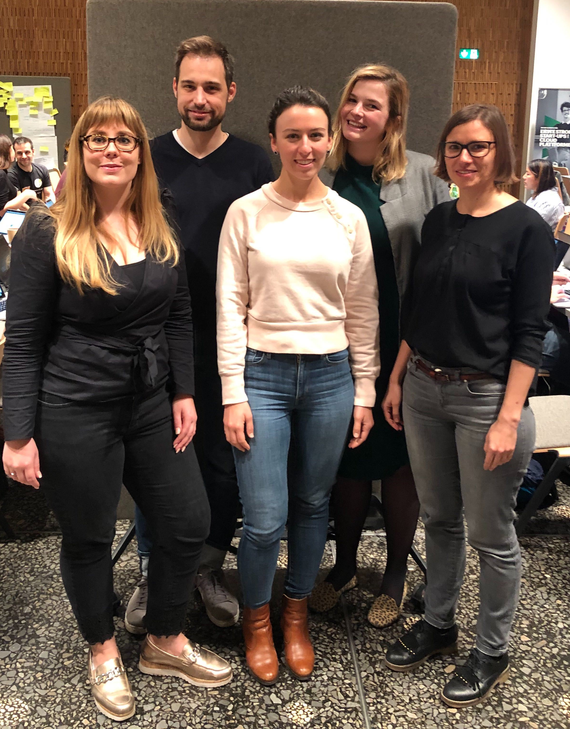
THANKS!

